Slide 1







The Indian Premier League
CRICKET
The Game of Bat and Ball
PRESENTED BY RESHMI BAR

Slide 2
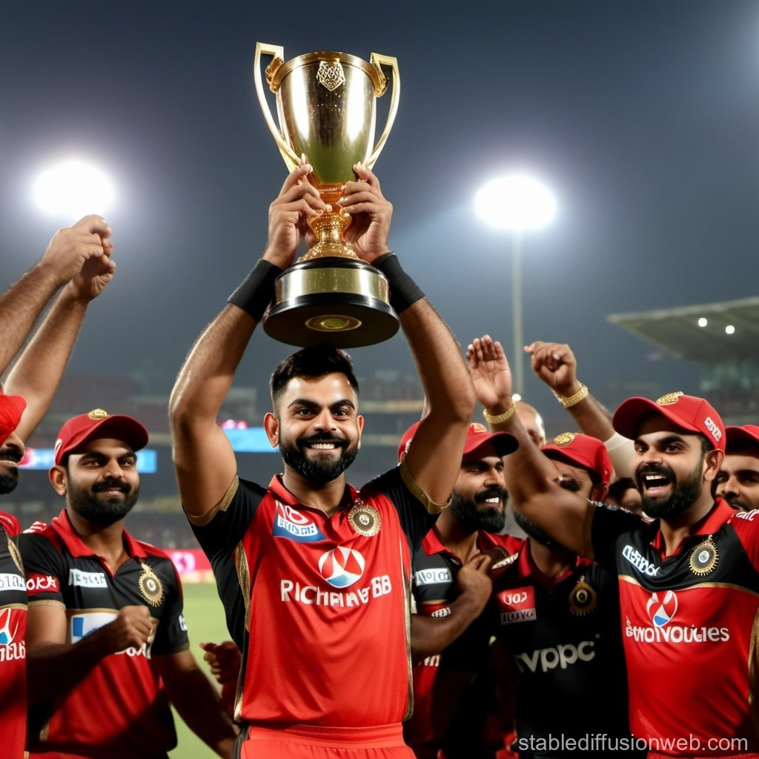


WHAT IS IPL?
The IPL (Indian Premier League) is a professional T20 cricket league in India, organized by the Board of Control for Cricket in India (BCCI). It is one of the most popular and richest cricket leagues in the worldFormat: Twenty20 (T20) – Each team plays 20 overs per match.
Launched: 2008
Season: Held annually, usually between March and May.
Teams: Franchises representing Indian cities (e.g., Mumbai Indians, Chennai Super Kings).
Players: Mix of Indian and international stars.
Revenue: Generates billions through broadcasting, sponsorships, and merchandise.
The Game of Bat and Ball

Slide 3



Initial Teams (2008):
Chennai Super Kings (CSK)
Mumbai Indians (MI)
Royal Challengers Bangalore (RCB)
Kolkata Knight Riders (KKR)
Delhi Daredevils (now Delhi Capitals)
Rajasthan Royals (RR)
Kings XI Punjab (now Punjab Kings)
Deccan Chargers (now defunct)
HISTORY OF IPL CRICKET
From 2008 April–June Founder: Lalit Mod
The Indian Premier League (IPL) was launched in 2008 by the Board of Control for Cricket in India (BCCI). It was inspired by the success of global sports leagues like the English Premier League and NBA, as well as India’s own ICL (Indian Cricket League), which was not officially recognized.

Slide 4

IPL CAPSTONE PROJECT ASSIGNMENT
How the Game is Played
Dataset Description
The IPL dataset includes detailed information about each season’s matches, player performances, ball-by-ball deliveries, team details, and match results. It enables rich analysis of game outcomes, player efficiency, team strategies, venue advantages, and performance trends across different IPL seasons

Slide 5
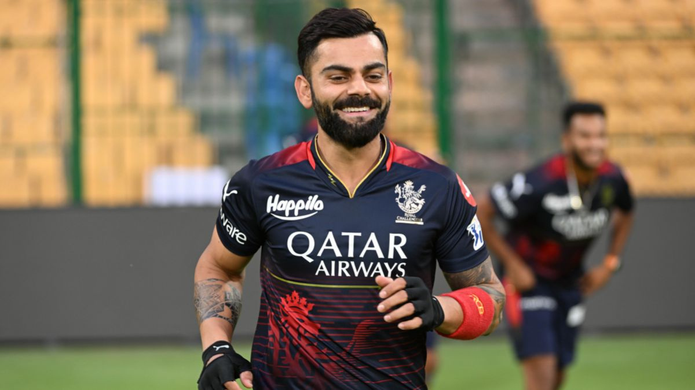


IPL DATA ANALYSIS
POWER BI Dashboards
Python: Exploratory Data Analysis (EDA)
DATA ANALYSING TOOLS
MySQL: IPL Analytical Questions

Slide 6
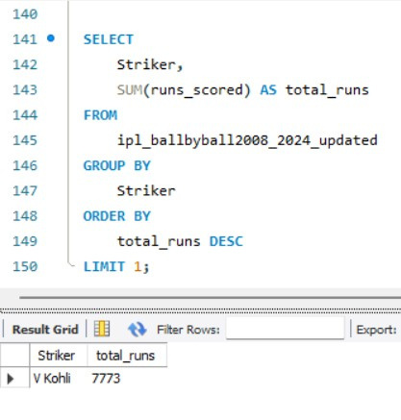

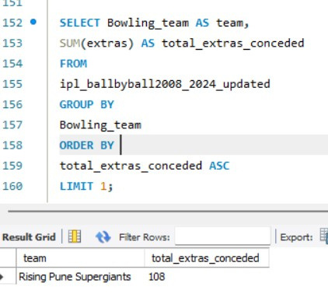
Which batsman has scored the highest total runs?
SQL QUERIES TO SOLVE THE FOLLOWING:
22.Which team has conceded the least extras in the matches?

Slide 7
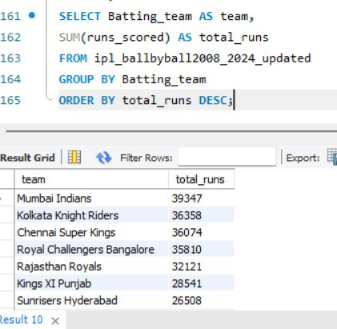
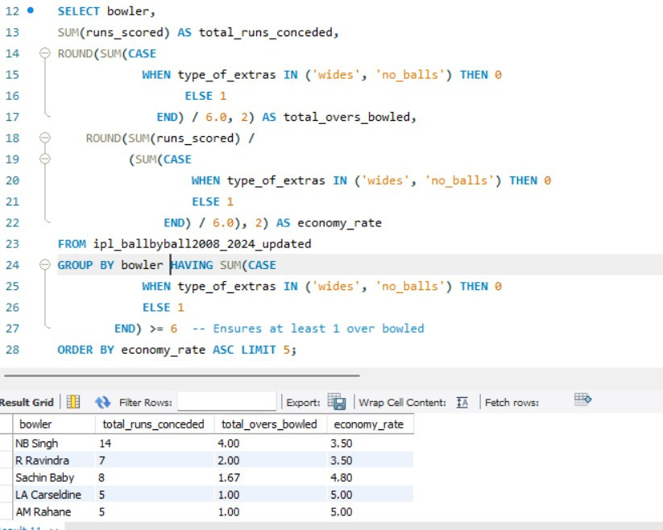

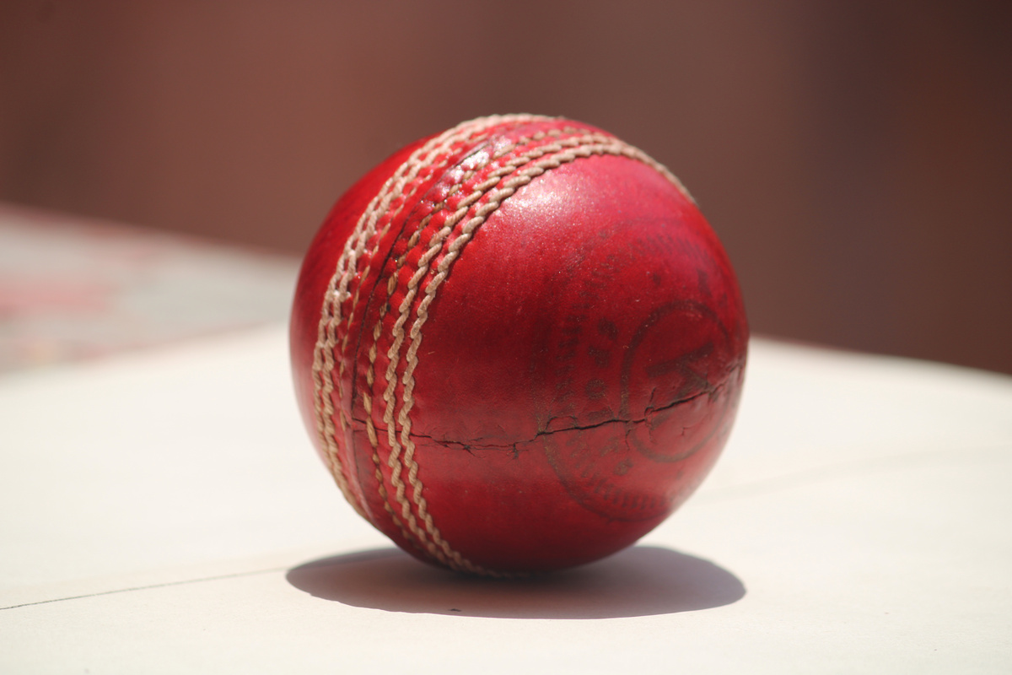
3.What is the total number of runs scored by each team across all matches?
4.Who are the top 5 bowlers based on runs conceded per over (economy rate)?

Slide 8


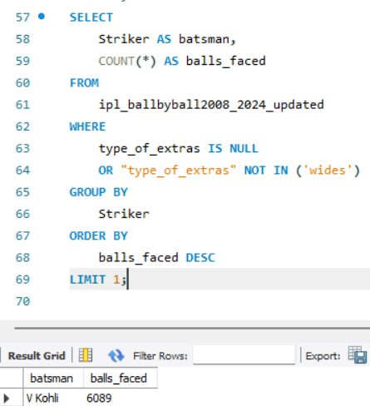
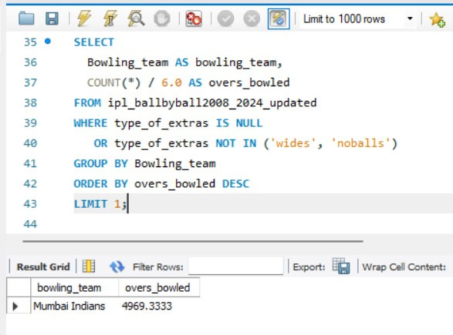
5.Which batsman has faced the most balls?
6.Which bowling team has taken part in the most overs?

Slide 9
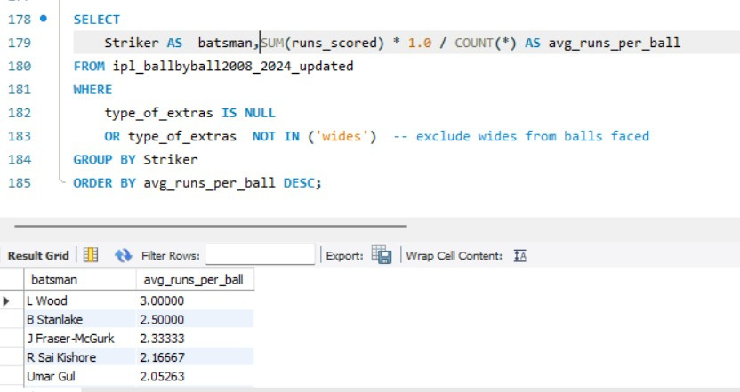
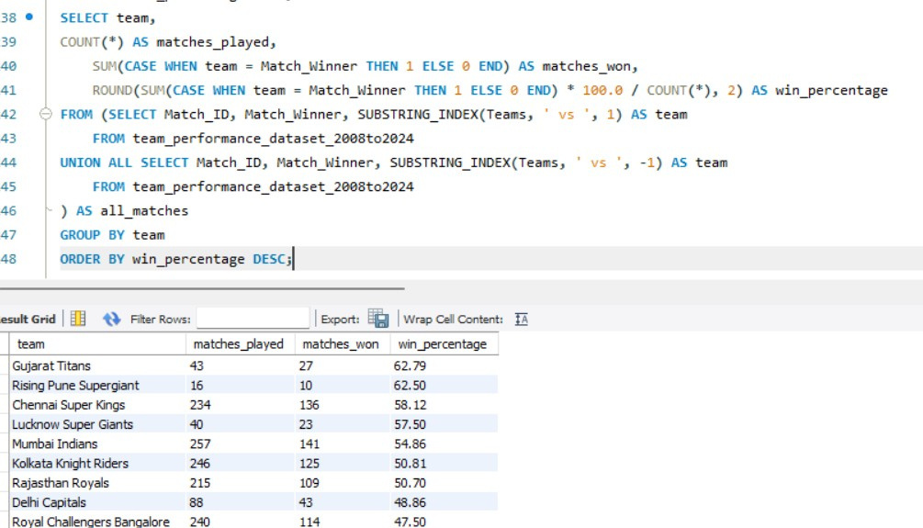

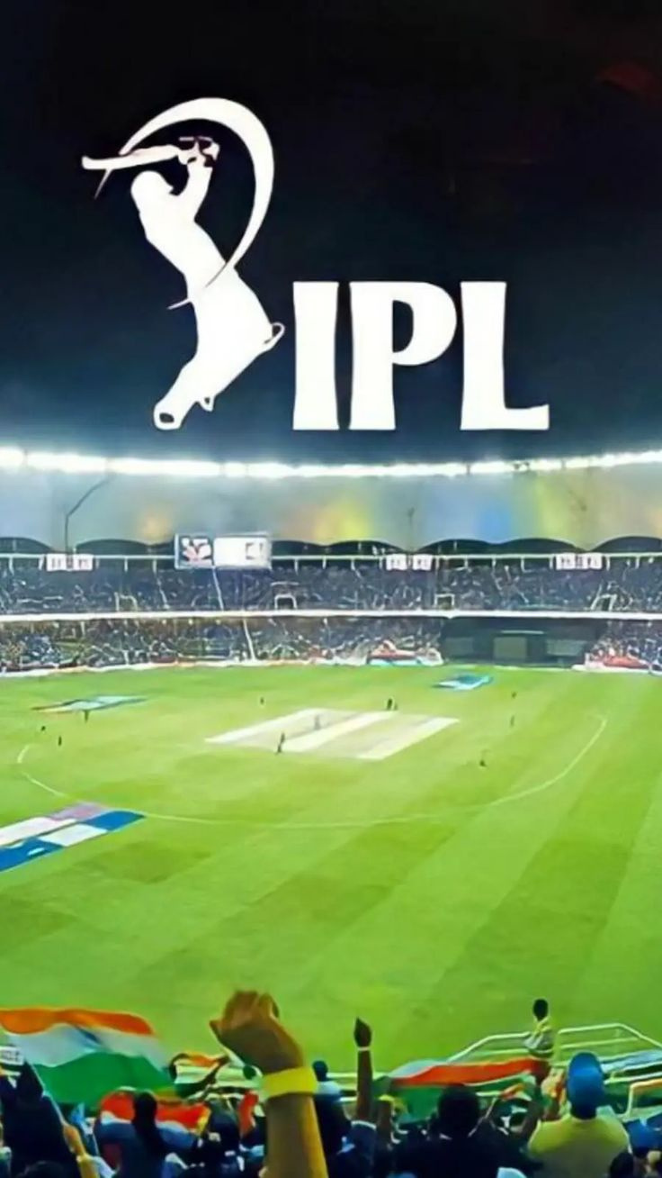

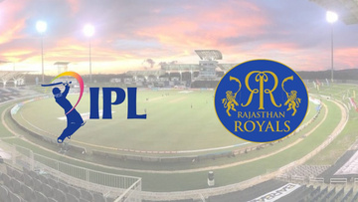
7.What is the average number of runs scored per ball by each batsman?
8.Which teams have the best win percentage according to the team_performance table?

Slide 10
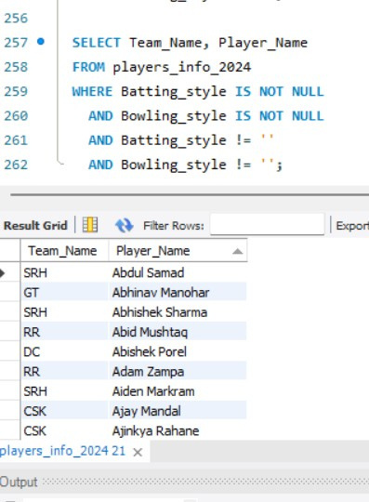
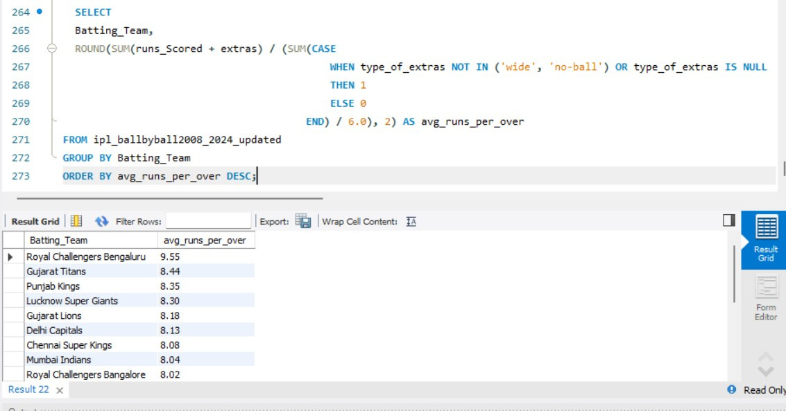
9.List all players who are all-rounders (both batting and bowling style available).
9
10.What is the average number of runs scored per over by each batting team?

Slide 11
Thynk Unlimited
THANK
YOU
Keep Playing Cricket!

Slide 12


IPL
HOME
SERVICE
ABOUT US
CONTACT US
CRICKET
IPL USING POWER BI

Slide 13


IIPL
HOME
SERVICE
ABOUT US
CONTACT US
WELCOME TO DASHBOARD 01
1. TEAM PERFORMANCE DASHBOARD
I
MATCHES PLAYED PER SEASON
WINNER & RUNNER-UP TEAMS
TOTAL RUNS SCORED BY SEASON
NUMBER OF SIXES/FOURS PER SEASON
AVERAGE WINNING MARGIN (RUNS/WICKETS)

Slide 14
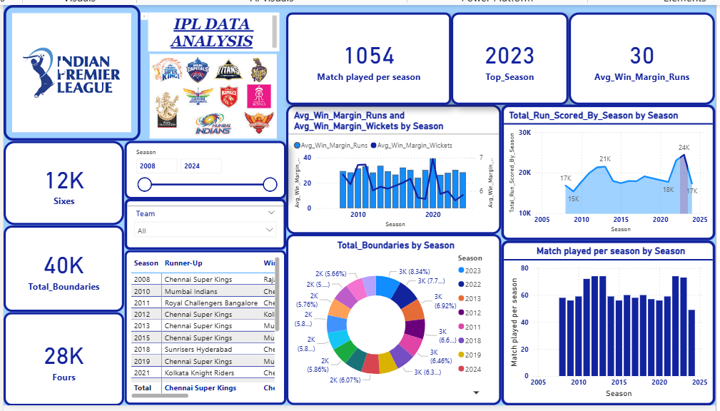

Slide 15


SUMMARY OF INSIGHTS TABLE
2023 WAS THE MOST DOMINANT SEASON IN RUNS AND WIN MARGINS.
CHENNAI SUPER KINGS HAD THE MOST CONSISTENT FINAL APPEARANCES.
MOST BOUNDARIES WERE HIT IN 2022 AND 2023.
TOTAL OF 40K BOUNDARIES (28K FOURS, 12K SIXES).
FILTERS USED
SEASON SLICER (2008–2024): LETS USERS VIEW TRENDS ACROSS ANY SELECTED RANGE OF SEASONS.
Your Description Here
Your Description Here
TEAM DROPDOWN: ALLOWS ANALYSIS OF A SPECIFIC TEAM'S SEASONAL STATS.
THIS DASHBOARD PROVIDES A SEASON-LEVEL OVERVIEW OF IPL PERFORMANCE METRICS FROM 2008 TO 2024, FOCUSING ON BATTING MILESTONES, MATCH STATISTICS, WIN MARGINS, AND SEASON OUTCOMES.

Slide 16


WELCOME TO DASHBOARD 02
LARANA CLUB
HOME
SERVICE
ABOUT US
CONTACT US
TEAM PERFORMANCE
TEAM-WISE WIN PERCENTAGE
WINS BY TOSS DECISION (BAT/FIELD)
TEAM'S MATCH RESULT TRENDS BY SEASON
HEAD-TO-HEAD WINS/LOSSES
PERFORMANCE IN FINALS
Vision
Mission

Slide 17
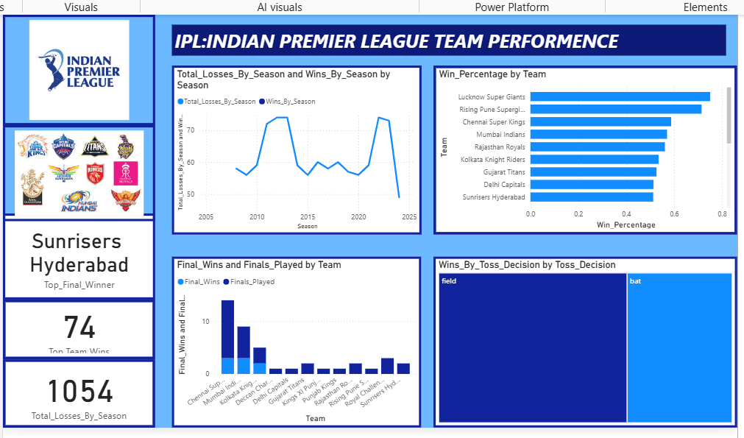

Slide 18
Summary of Insights Table
6 KEY INSIGHTS FROM THE DASHBOARD
1. SUNRISERS HYDERABAD MARKED AS “TOP FINAL WINNER”
2. TOTAL TEAM WINS = 74 (FOR SELECTED FILTER/TEAM)
1054 TOTAL LOSSES BY SEASON (CUMULATIVE)
4. TEAM WITH BEST WIN %: LUCKNOW SUPER GIANTS
5. CHENNAI SUPER KINGS DOMINATE IN FINALS PLAYED & WON
6. TOSS DECISIONS MATTER: FIELDING WINS MORE THAN BATTING

Slide 19
LARANA CLUB
HOME
SERVICE
ABOUT US
CONTACT US
WELCOME TO DASHBLOARD 03
PLAYER STATISTICS
TOP RUN SCORERS AND AVERAGE PER SEASON
TOP WICKET TAKERS AND ECONOMY RATES
MOST SIXES, MOST BOUNDARIES
PLAYER OF THE MATCH AWARDS
ALL-ROUNDER PERFORMANCES

Slide 20
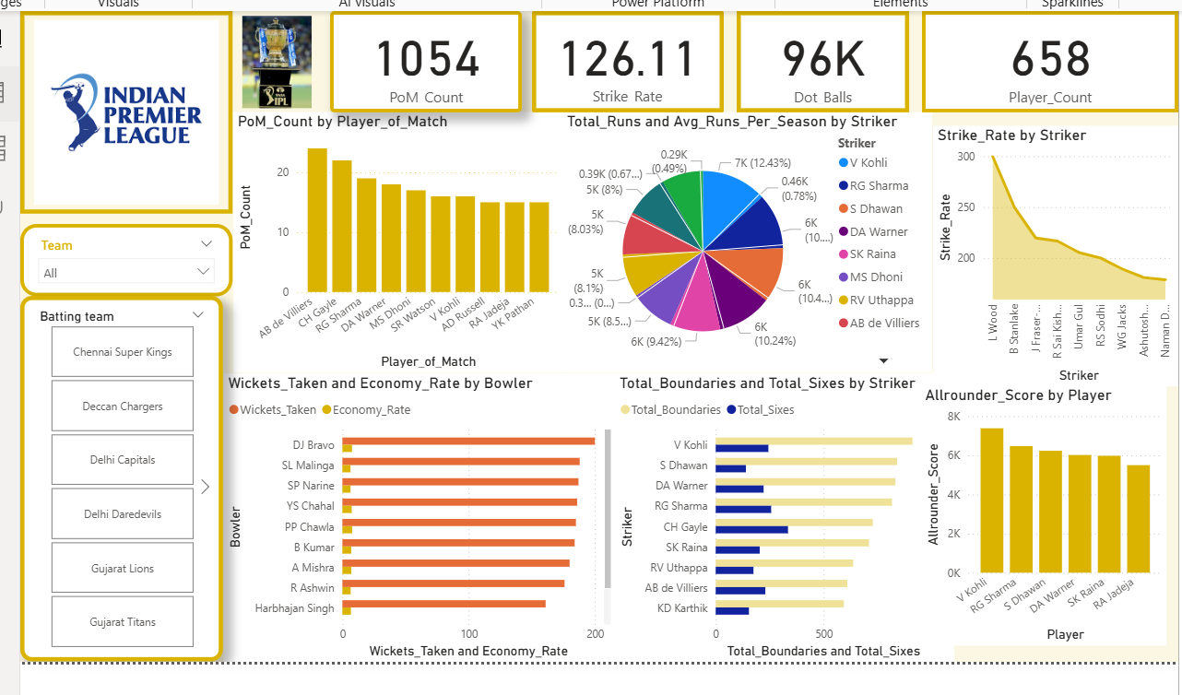

Slide 21

IPL PLAYER-LEVEL PERFORMANCE DASHBOARD
HOME
SERVICE
ABOUT US
CONTACT US
PLAYER-LEVEL PERFORMANCE, COVERING BATTING, BOWLING, AND ALL-ROUND METRICS.
PIE CHARTS, BAR CHARTS, COMBO VISUALS — INTERACTIVE BREAKDOWN BY TEAM/PLAYER.
1. AB DE VILLIERS HAS THE MOST PLAYER OF THE MATCH AWARDS
2. OVERALL STRIKE RATE IS 126.11
3. 96K DOT BALLS DELIVERED
4. TOP ALL-ROUNDER: VIRAT KOHLI
5. HIGHEST STRIKE RATE: L. WOOD
6. TOP WICKET TAKERS: DJ BRAVO AND SL MALINGA
7. MOST BOUNDARIES: VIRAT KOHLI
8. TOTAL PLAYERS ANALYZED: 658

Slide 22

LARANA CLUB
HOME
SERVICE
ABOUT US
CONTACT US
WELCOME TO DASHBOARD 03
DASHBOARD 4: VENUE ANALYSIS
TOP VENUES BY MATCHES PLAYED
VENUE-WISE AVERAGE SCORES
TEAM-WISE WIN % BY VENUE
TOSS OUTCOME AND RESULT PATTERN PER VENUE
HOME VS AWAY PERFORMANCE

Slide 23
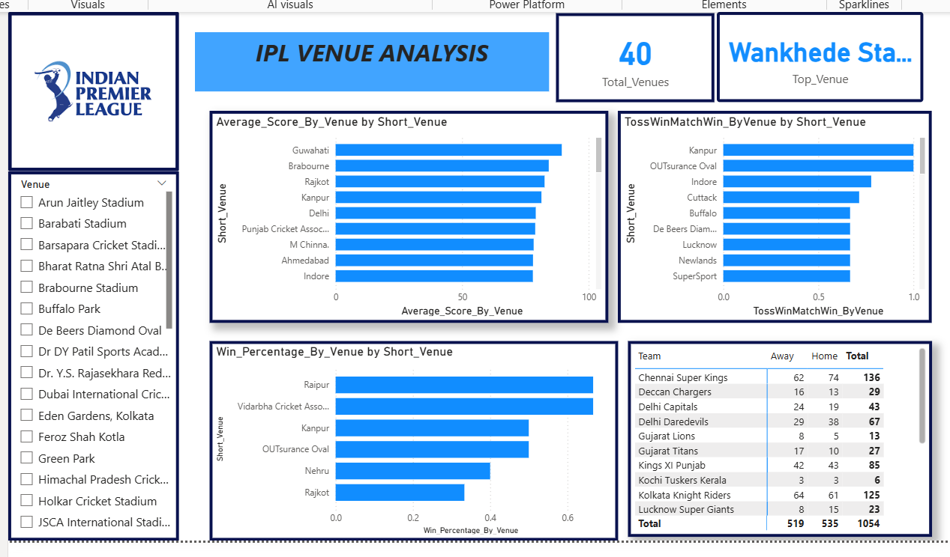

Slide 24
IPL VENUE ANALYSIS DASHBOARD
HOME
SERVICE
ABOUT US
CONTACT US
VENUES TRACKED 40 UNIQUE IPL VENUES INCLUDING INDIA AND INTERNATIONAL LOCATIONS.
TOP PERFORMING VENUE WANKHEDE STADIUM — LIKELY MOST MATCHES, ICONIC PERFORMANCES.
7 KEY INSIGHTS FROM THE DASHBOARD
HIGH SCORING GROUND GUWAHATI — BEST FOR BATTING (HIGHEST AVG SCORE).
1. TOTAL VENUES USED: 40
TOSS IMPACT VENUES KANPUR, INDORE — TOSS OFTEN PREDICTS MATCH OUTCOME.
2. TOP VENUE: WANKHEDE STADIUM
BEST WIN % GROUNDS RAIPUR AND NAGPUR'S VCA STADIUM.
3. HIGHEST AVERAGE SCORE: GUWAHATI
MOST ACTIVE TEAMS CSK AND KKR DOMINATE IN TOTAL MATCHES PLAYED.
4. TOSS-WIN = MATCH-WIN DOMINANCE IN KANPUR
MATCH DISTRIBUTION ALMOST EQUAL HOME VS. AWAY MATCHES (BALANCED IPL SCHEDULING).
5. BEST WINNING VENUES: RAIPUR AND VCA (NAGPUR)
6. CHENNAI SUPER KINGS PLAYED THE MOST MATCHES
7. HOME ADVANTAGE APPEARS BALANCED
8. TOTAL PLAYERS ANALYZED: 658

Slide 25
WELCOME TO DASBOARD 05
HOME
SERVICE
ABOUT US
CONTACT US
MATCH SITUATIONS
MATCHES WON BY CHASING VS DEFENDING
SUPER OVER MATCHES OVERVIEW
PERFORMANCE IN POWERPLAY, MIDDLE, DEATH OVERS
FALL OF WICKETS TIMING
PRESSURE PERFORMANCE: LAST 5 OVERS

Slide 26
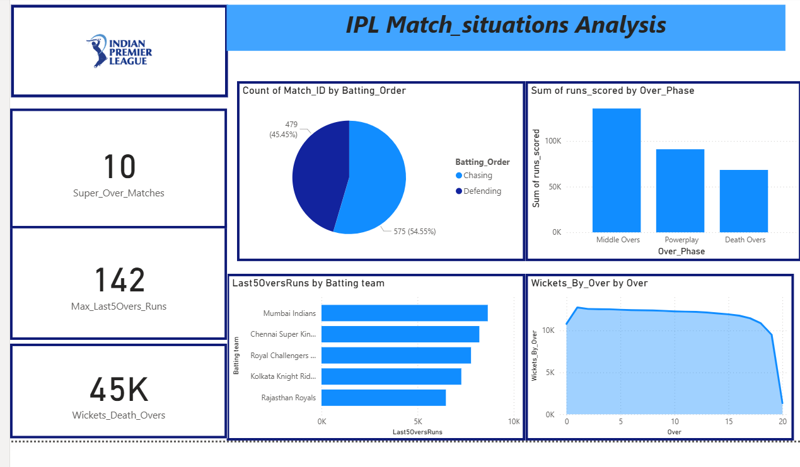

Slide 27
IPL MATCH SITUATIONS ANALYSIS
HOME
SERVICE
ABOUT US
CONTACT US
4. HIGHEST LAST 5 OVERS TOTAL: 142 RUNS
A SINGLE TEAM HAS MANAGED TO SCORE 142 RUNS IN THE LAST 5 OVERS — AN EXCEPTIONALLY HIGH FIGURE, SHOWING EXPLOSIVE FINISH POTENTIAL IN T20 CRICKET.
6 KEY INSIGHTS FROM THE DASHBOARD
1. CHASING IS MORE COMMON THAN DEFENDING
5. MUMBAI INDIANS DOMINATE IN LAST 5 OVERS
FROM THE PIE CHART:
575 MATCHES (54.55%) HAD TEAMS CHASING.
479 MATCHES (45.45%) WERE DEFENDING TOTALS.
TOP CONTRIBUTORS IN LAST50OVERSRUNS (I.E., EXPLOSIVE FINISHING):
MUMBAI INDIANS LEAD, FOLLOWED BY CHENNAI SUPER KINGS AND ROYAL CHALLENGERS BANGALORE.
2. MOST RUNS ARE SCORED IN MIDDLE OVERS
THE BAR CHART SHOWING SUM OF RUNS BY OVER PHASE:
MIDDLE OVERS (7–15) CONTRIBUTE THE MOST RUNS, MORE THAN EVEN THE DEATH OVERS.
DEATH OVERS SCORE THE LEAST, POSSIBLY DUE TO INCREASED WICKETS FALLING.
6. WICKETS PEAK AT START AND END OF INNINGS
WICKETS_BY_OVER LINE CHART SHOWS:
EARLY OVERS (1–2) SEE A SPIKE IN WICKETS, AS BOWLERS EXPLOIT CONDITIONS.
ANOTHER SPIKE NEAR 18TH–20TH OVERS, AS BATTERS TAKE HIGH RISKS.
MIDDLE OVERS ARE RELATIVELY STABLE.
3. SUPER OVER MATCHES ARE RARE
ONLY 10 MATCHES HAVE GONE INTO SUPER OVER SITUATIONS — INDICATES RARITY AND COMPETITIVENESS.

Slide 28
WELCOME TO DASBOARD 06
HOME
SERVICE
ABOUT US
CONTACT US
SEASON-WISE TRENDS
Player participation trend by season
Match totals vs overs comparison
Strike rate evolution over years
Bowling economy trends
Season-level KPI dashboard

Slide 29
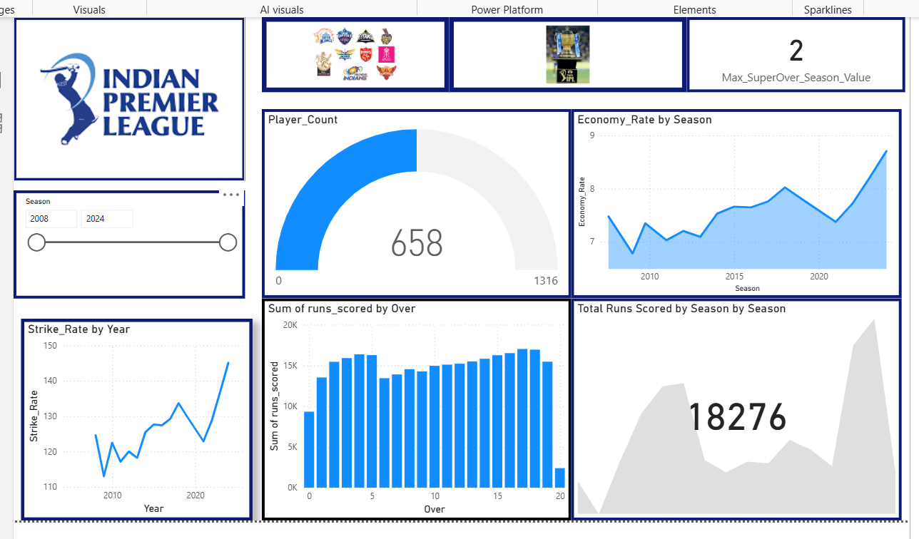

Slide 30
IPL SEASON TRENDS ANALYSIS
HOME
SERVICE
ABOUT US
CONTACT US
5. OVER 650 PLAYERS USED SO FAR
THE GAUGE SHOWS 658 PLAYERS OUT OF 1316.
Indicates a rich talent pool and player rotation in the IPL.
6 KEY INSIGHTS FROM THE DASHBOARD
1. RISING ECONOMY RATE OVER THE YEARS
ECONOMY RATE BY SEASON SHOWS A CLEAR INCREASE, ESPECIALLY AFTER 2020.
IT HAS CLIMBED FROM ~7 TO ABOVE 9, INDICATING:
BOWLERS ARE BEING HIT FOR MORE RUNS PER OVER.
T20 BECOMING MORE BATTING-DOMINANT.
6. MAXIMUM SUPER OVERS IN A SEASON: 2
THOUGH RARE, A MAXIMUM OF 2 SUPER OVERS OCCURRED IN A SEASON.
Indicates most matches end within regular time — high clarity in outcomes.
2. CONSISTENT GROWTH IN STRIKE RATE
HE STRIKE RATE BY YEAR CHART ALSO SHOWS A RISING TREND.
Particularly high jump around 2024.
Suggests batters are becoming more aggressive and efficient.
3. DEATH OVERS CONTRIBUTE THE MOST RUNS
IN SUM OF RUNS BY OVER, OVERS 16–19 CONTRIBUTE THE MOST RUNS.
Indicates the importance of finishers and death-over strategy.

Slide 31
WHAT NEEDS IMPROVEMENT (IPL-LEVEL)
HOME
SERVICE
ABOUT US
CONTACT US
CRICKETING STRATEGIES
BOWLING IN DEATH OVERS: DEATH OVERS LEAK THE MOST RUNS; TEAMS NEED TO STRENGTHEN DEATH BOWLING.
STRIKE RATE FOCUS: TEAMS MUST PRIORITIZE HIGH-STRIKE-RATE PLAYERS ESPECIALLY IN LOWER MIDDLE ORDER.
TOSS ADVANTAGE: IN SOME VENUES (E.G., KANPUR), TOSS-WINNERS HAVE AN OUTSIZED WIN ADVANTAGE — TEAMS SHOULD ADAPT BETTER WHEN LOSING THE TOSS.
VENUE-SPECIFIC PLANNING: WIN PERCENTAGES VARY DRASTICALLY — TEAMS NEED TAILORED STRATEGIES PER GROUND.
POWERPLAY UTILIZATION: POWERPLAY IS UNDER-LEVERAGED BY SOME TEAMS COMPARED TO MIDDLE OVERS.

Slide 32
LARANA CLUB
HOME
SERVICE
ABOUT US
CONTACT US
THANK YOU

